Slide 1

Lesson 9– Path planning
Intelligent Mobile Robotics
Dr. Aboozar Taherkhani (PhD)
email: aboozar.taherkhani@dmu.ac.uk

Slide 2
Pathplanning
Different path Planning algorithms:
Graph based
Topological
G.A.
They all need some form of configuration space or CSpace

Slide 3
Pathplanning
A mapped environment:

Slide 4
C Space
A grid:

Slide 5
C Space
A meadow map:
A number of convex polygon (interior angle is less than 180º )

Slide 6
C Space
A generalised Voronoi graph:

Slide 7
C Space
A Relational Model (landmarks and gateways):
landmarks
gateways

Slide 8
Grid Based Pathplanning
A* (or D*) path planning

Slide 9
Grid Based Pathplanning
Easy to construct
Lets look at A*

Slide 10
A* Search
Variant of best first
Guaranteed to find the shortest path when:
The quality measure works on partial paths
The newest node is added to the head of the list and the list is reordered

Slide 11
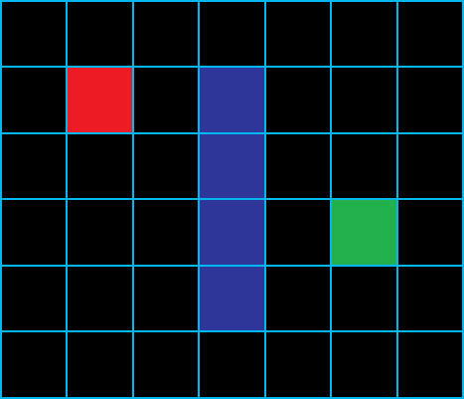
A*
Start in the red node
Goal is the green node
Blue nodes are walls
Number of nodes = w X h
Open and closed list of nodes
Each node is given an F,G and H score

Slide 12
A*
Scoring the node:
G Score
Think of geographical score
The distance it has taken to get from the starting node to the current node
H Score
Think of heuristic score
The estimated distance from the current node to the goal node
We’ll use Euclidean distance
F Score
Think of final score
F = G + H

Slide 13
A* Pseudo Code
create the open list of nodes, initially containing only our starting node
create the closed list of nodes, initially empty
while (we have not reached our goal) {
consider the best node in the open list (the node with the lowest f value)
if (this node is the goal) {
then we're done
}
else {
move the current node to the closed list and consider all of its neighbours
for (each neighbour) {
if (this neighbour is in the closed list and our current g value is lower) {
update the neighbour with the new, lower, g value
change the neighbour's parent to our current node
}
else if (this neighbour is in the open list and our current g value is lower) {
update the neighbour with the new, lower, g value
change the neighbour's parent to our current node
}
else this neighbour is not in either the open or closed list {
add the neighbour to the open list and set its g value
}
}
}
}

Slide 14
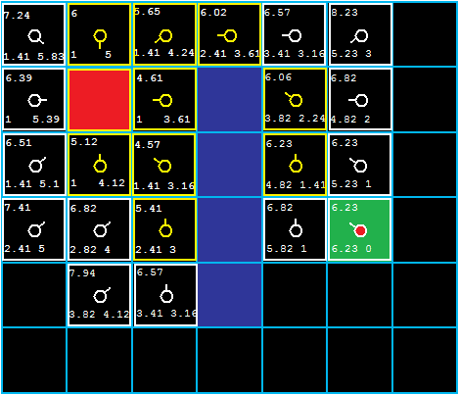
A* (A star)
Run until goal node is found
Reconstruct path using record of parent nodes

Slide 15
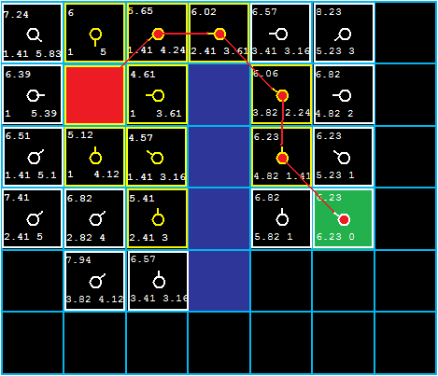
A* (A star)
Run until goal node is found
Reconstruct path using record of parent nodes
A* pathplaning: https://www.youtube.com/watch?v=-L-WgKMFuhE

Slide 16
Wavefront Path planning
BFS (Breadth First Search) alternative to A*
BFS search from goal to start node
Only based on geographical score
Move to the (unvisited) adjacent node with the lowest score
If you have a choice, take the node which requires the least turning

Slide 17
Wavefront Pathplanning
BFS path planning
Start
 | 15
 | 14 | 14 |  |  |  |  |  |  | 6
 | 13 | 13 |  |  |  |  |  |  | 5 | 5
 | 12 | 12 |  |  |  |  |  |  | 4 | 4
 | 12 | 11 |  |  |  |  |  |  | 3 | 3
 |  | 10 | 9 | 8 | 7 | 6 | 5 | 4 | 3 | 2
 |  |  |  |  |  |  |  |  |  | 1
 |  |  |  |  |  |  |  |  |  | 0
Goal

Slide 18
Wavefront Pathplanning
BFSpathplanning
 | 15
 | 14 | 14 |  |  |  |  |  |  | 6
 | 13 | 13 |  |  |  |  |  |  | 5 | 5
 | 12 | 12 |  |  |  |  |  |  | 4 | 4
 | 12 | 11 |  |  |  |  |  |  | 3 | 3
 |  | 10 | 9 | 8 | 7 | 6 | 5 | 4 | 3 | 2
 |  |  |  |  |  |  |  |  |  | 1
 |  |  |  |  |  |  |  |  |  | 0

Slide 19
Wavefront Pathplanning
BFSpathplanning
 | 15
 | 14 | 14 |  |  |  |  |  |  | 6
 | 13 | 13 |  |  |  |  |  |  | 5 | 5
 | 12 | 12 |  |  |  |  |  |  | 4 | 4
 | 12 | 11 |  |  |  |  |  |  | 3 | 3
 |  | 10 | 9 | 8 | 7 | 6 | 5 | 4 | 3 | 2
 |  |  |  |  |  |  |  |  |  | 1
 |  |  |  |  |  |  |  |  |  | 0

Slide 20
Wavefront Pathplanning
BFS path planning
 | 15
 | 14 | 14 |  |  |  |  |  |  | 6
 | 13 | 13 |  |  |  |  |  |  | 5 | 5
 | 12 | 12 |  |  |  |  |  |  | 4 | 4
 | 12 | 11 |  |  |  |  |  |  | 3 | 3
 |  | 10 | 9 | 8 | 7 | 6 | 5 | 4 | 3 | 2
 |  |  |  |  |  |  |  |  |  | 1
 |  |  |  |  |  |  |  |  |  | 0

Slide 21
Wavefront Pathplanning
BFS path planning
 | 15
 | 14 | 14 |  |  |  |  |  |  | 6
 | 13 | 13 |  |  |  |  |  |  | 5 | 5
 | 12 | 12 |  |  |  |  |  |  | 4 | 4
 | 12 | 11 |  |  |  |  |  |  | 3 | 3
 |  | 10 | 9 | 8 | 7 | 6 | 5 | 4 | 3 | 2
 |  |  |  |  |  |  |  |  |  | 1
 |  |  |  |  |  |  |  |  |  | 0

Slide 22
Wavefront Pathplanning
BFS path planning
 | 15
 | 14 | 14 |  |  |  |  |  |  | 6
 | 13 | 13 |  |  |  |  |  |  | 5 | 5
 | 12 | 12 |  |  |  |  |  |  | 4 | 4
 | 12 | 11 |  |  |  |  |  |  | 3 | 3
 |  | 10 | 9 | 8 | 7 | 6 | 5 | 4 | 3 | 2
 |  |  |  |  |  |  |  |  |  | 1
 |  |  |  |  |  |  |  |  |  | 0

Slide 23
Meadow Maps
A meadow map:

Slide 24
Meadow Maps
A meadow map:
Divides the map into convex polygons
Interior of each polygon represents a “safe zone”
Robot can move anywhere inside these polygons

Slide 25
Meadow Maps
Place a vertex half way along every shared edge

Slide 26
Meadow Maps
A meadow map, topological planning:

Slide 27
Meadow Maps
A meadow map, topological planning:

Slide 28
Generalised Voronoi Graph
Example

Slide 29
Generalised Voronoi Graph
Divide space into Voronoi edges
These edges are equidistant from all points
Can be calculated on the fly
Can also be reasoned with (A*)
Wander when obstacles are out of range
Keep obstacles equidistant when in range

Slide 30
Generalised Voronoi Graph
Navigation:

Slide 31
Generalised Voronoi Graph
Navigation:

Slide 32
Generalised Voronoi Graph
Navigation:

Slide 33
Generalised Voronoi Graph
Navigation:
Obstacle detected

Slide 34
Generalised Voronoi Graph
Navigation:
Two obstacles
detected

Slide 35
Generalised Voronoi Graph
Navigation:
Follow the
Midpoint
This is the
Voronoi edge
Two obstacles
detected

Slide 36
Generalised Voronoi Graph
Navigation:

Slide 37
Generalised Voronoi Graph
Navigation:
Three obstacles
detected
Mark as node

Slide 38
Generalised Voronoi Graph
Navigation:
Forms a navigable
graph

Slide 39
Topological Maps
Detection of landmarks is the key
Think of driving instructions:
Slight right at St Nicholas Circle 459 ft
Keep left at the fork
Continue to follow A47 0.1 mi
Take the ramp onto Vaughan Way/A594 315 ft
Slight left at Highcross St

Slide 40
Topological Maps
Detection of landmarks is the key
Think of driving instructions:
Slight right at St Nicholas Circle 459 ft
Keep left at the fork
Continue to follow A47 0.1 mi
Take the ramp onto Vaughan Way/A594 315 ft
Slight left at Highcross St
Landmarks
...And instructions to navigate between them

Slide 41
Topological Maps
Example getting from A to B
A
B

Slide 42
Topological Maps
Example getting from A to B
A
Here
Move forward beyond the doorway
B

Slide 43
Topological Maps
Example getting from A to B
A
Move forward until the wall directly in front is approximately 30cms away
Here
B

Slide 44
Topological Maps
Example getting from A to B
A
Turn 90° counter clockwise
Here
B

Slide 45
Topological Maps
Example getting from A to B
A
Move forward until the obstacle to the right is approx 90cm away and the left is approx 30cm away
Here
B

Slide 46
Topological Maps
Example getting from A to B
A
Move forward until the obstacle to the right is approx 30cm away and increases to 90cm
B
Here

Slide 47
(A Very Brief) Introduction to SLAM
Simultaneous Localization And Mapping
For details see Slam paper in LZ

Slide 48
The Concept
Scene contains landmarks

Slide 49
The Concept
Robot perceives landmarks

Slide 50
The Concept
Robot moves – position estimated from odometry

Slide 51
The Concept
Robot moves – position estimated from landmarks

Slide 52
The Concept
Two possible positions – real position is in between

Slide 53
The Concept
Two possible positions – real position is in between

Slide 54
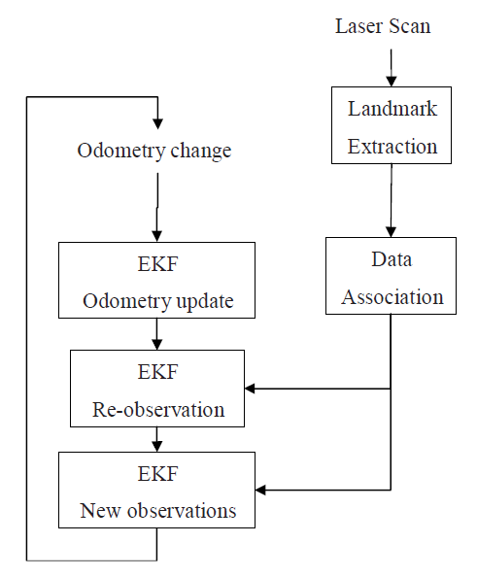
The SLAM Process

Slide 55
Overview
Landmark extraction
Map formed of discrete landmarks
A different approach to occupancy grids
Data Association
Have I seen this before?
Attempt to match observed landmark to previously recorded landmarks
Extended Kalman Filter
Form of Bayesian filter
Uses covariance and rates of change – are landmarks moving together?

Slide 56
Landmark Extraction
Method depends on sensors
Two main approaches:
Outliers (spikes)
Noise – will be eliminated by filter
Spike features – table legs etc
Inliers (RANSAC)
Lines, shapes
Corners make good landmarks

Slide 57
Landmark Extraction
Outliers (Spike Landmark Extraction )
Noise – will be eliminated by filter
Spike features – table legs etc

Slide 58
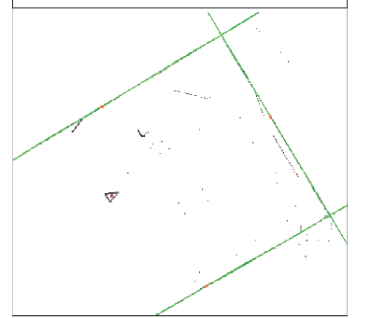
Landmark Extraction
Method depends on sensors
Inliers (RANSAC)
Lines, shapes
Corners make good landmarks

Slide 59
Data Association
Nearest neighbour method
Extract landmarks
For each landmark
Find closest landmark in landmark database
Compare landmarks, if they match increment observation count, if not add landmark to database with one observation
Only consider landmarks observed at least N times

Slide 60
EKF
Connects all parts of SLAM
Matrices hold
Robot position
Landmark positions
Error
Rates of change of all of these
Gain to put everything together
Complex - see SLAM for Dummies for details
HILTI SLAM CHALLENGE 2022
https://hilti-challenge.com/

Slide 61
In Lab
Work on your second assignment.

